Slide 1

ITA0502 – Computer Vision
AI-Based Plastic Waste Detection in Water Bodies using Computer Vision.
Supervisor : Dr. R C Jeni Gracia
Students :
V. Venkata Susheel Chowdary - 192472060
Y. Abhay – 192411219
T. Gnana Ashwanth – 192472174
M. Jashwanth – 192472280
N. Venkata Sai Sohith - 192425140

Slide 2
Agenda
01
Introduction
02
Literature Review
Context and proposed system
Research direction and identified gaps
03
Problem Statement
04
Objectives
The challenge AquaGuard-AI addresses
Project goals and intended outcomes
05
System Architecture
06
Modules Introduction
End-to-end design and data flow
Five modules and team ownership

Slide 3
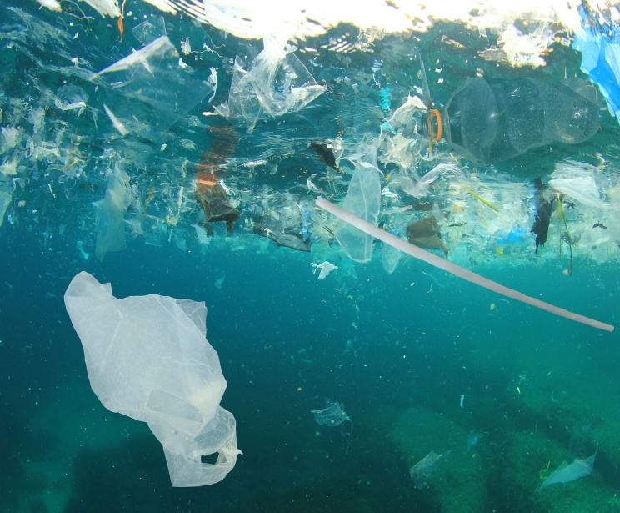
INTRODUCTION
Plastic pollution in water bodies is a major environmental challenge worldwide.
Manual monitoring of plastic waste is time-consuming, expensive, and inefficient.
Computer Vision enables automatic detection and analysis of plastic waste from images.
Deep learning models accurately recognize and classify various plastic materials.
Real-time monitoring helps authorities take faster action to reduce pollution.
The proposed system provides an intelligent solution for sustainable water body management.

Slide 4
LITERATURE SURVEY
S.No. | Author & Year | Method / Model | Key Findings
1 | Chen & Zhu, 2024 | Lightweight YOLOv5 | Improved plastic waste detection on water surfaces with faster processing.
2 | Kirana et al., 2024 | YOLOv6 & YOLOv7 | Detected plastic bottles on water surfaces using deep learning.
3 | Wang et al., 2025 | Improved YOLO | Enhanced marine litter detection in challenging environments.
4 | Ma et al., 2025 | YOLOv12 | Supported real-time marine litter detection and pollution monitoring.
5 | 2025 Study | YOLOv8 + Object Tracking | Detected and tracked plastic bottles in rivers and streams.

Slide 5

PROBLEM STATEMENT
Large amounts of plastic waste accumulate in rivers, lakes, and oceans every day.
Traditional monitoring methods require extensive manpower and regular field inspections. Delayed detection of plastic waste increases environmental and marine ecosystem damage.
Existing systems often fail to provide continuous and real-time pollution monitoring.
Manual identification of waste is prone to errors and inconsistent reporting.
An automated Computer Vision-based system is needed for accurate and continuous plastic waste detection.

Slide 6
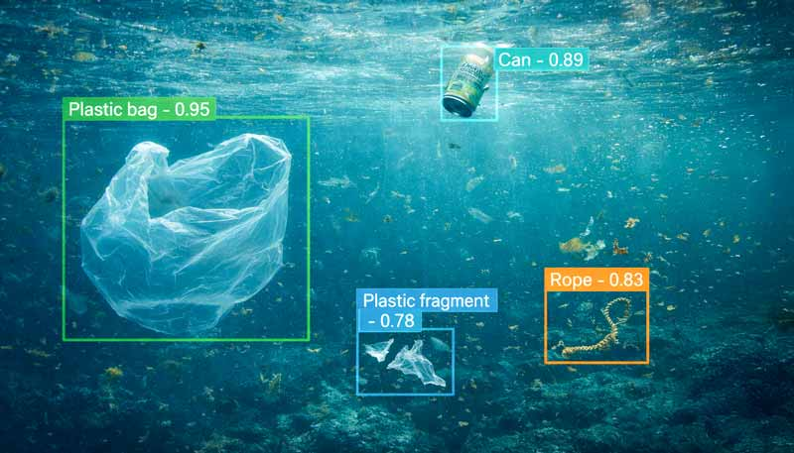
OBJECTIVES
Develop a Computer Vision-based system for automatic plastic waste detection in water bodies.
Detect and classify different types of floating plastic waste using deep learning models.
Monitor water bodies continuously through cameras, drones, or surveillance systems. Provide real-time alerts when significant plastic waste is detected.
Support environmental agencies in planning efficient cleanup and waste management activities.
Improve pollution monitoring accuracy while reducing manual effort and operational costs.

Slide 7
ARCHITECTURE DIAGRAM
END-TO-END FLOW
1. INPUT
2. PREPROCESS
3. DETECT
4. ANALYZE
5. PRESENT
Images / video
Validate • resize • enhance
YOLOv8 plastic detection
Masks • features • size
API • dashboard
DATA QUALITY / MODULE 5
EVALUATION / MODULE 5
RESULTS
Duplicate checks • image integrity • annotation readiness
Precision • recall • mAP • inference speed
Annotated images • prediction metadata • reports
Operational flow: user submits an image/video → API validates input → preprocessing and detector run → optional segmentation/features are attached → results are shown in the dashboard→ evaluates both data readiness and model performance.
07

Slide 8
MODULE INTRODUCTION
MODULE 1
Image Acquisition & Preprocessing
MODULE 2
Segmentation & Feature Extraction
V. Venkata Susheel Chowdary
Y. Abhay
192472060
192411219
MODULE 3
Plastic Waste Detection & Classification
MODULE 4
Dashboard & REST API
T. Gnana Ashwanth
M. Jashwanth
192472174
192472280
MODULE 5
Dataset Audit & Model Evaluation
N Venkata saisohith
• 192425140

Slide 9


